Slide 1




Path-Way-Services
Ullash Bhattacharjee 180104103
Mostafizur Rahman 180104112
Kaho Fardin Hasib 170204063

Slide 2
Introduction
The name of our project is PATH-WAY SERVICES. It is basically a website that will help people to purchase tickets of transports. Bus, Train and Launches are the most commonly used public transports. But for now, we develop this website for the bus transport. People can easily book their tickets according to the date and available route.

Slide 3
Project Summary
A website that will help to purchase tickets of public transports. Bus, Train and Launches are the most commonly used public transports. This project goal is to minimize the sufferings of purchasing tickets. Admin will keep the website updated with transport’s information. And for the users they can easily buy tickets, cancel booking , contact with the admin and so on.

Slide 4
Project Requirements
IDE – Vs Code
Front End Language – HTML , CSS , Bootstrap
Back End Language – PHP
Database – My SQL
For getting in to an active member and booking tickets in our website , people has to be an account on our website. After registration user can log in and use the website for their purposes.
Os – Windows XP and Above
Process – Intel Pentium or equivalent

Slide 5
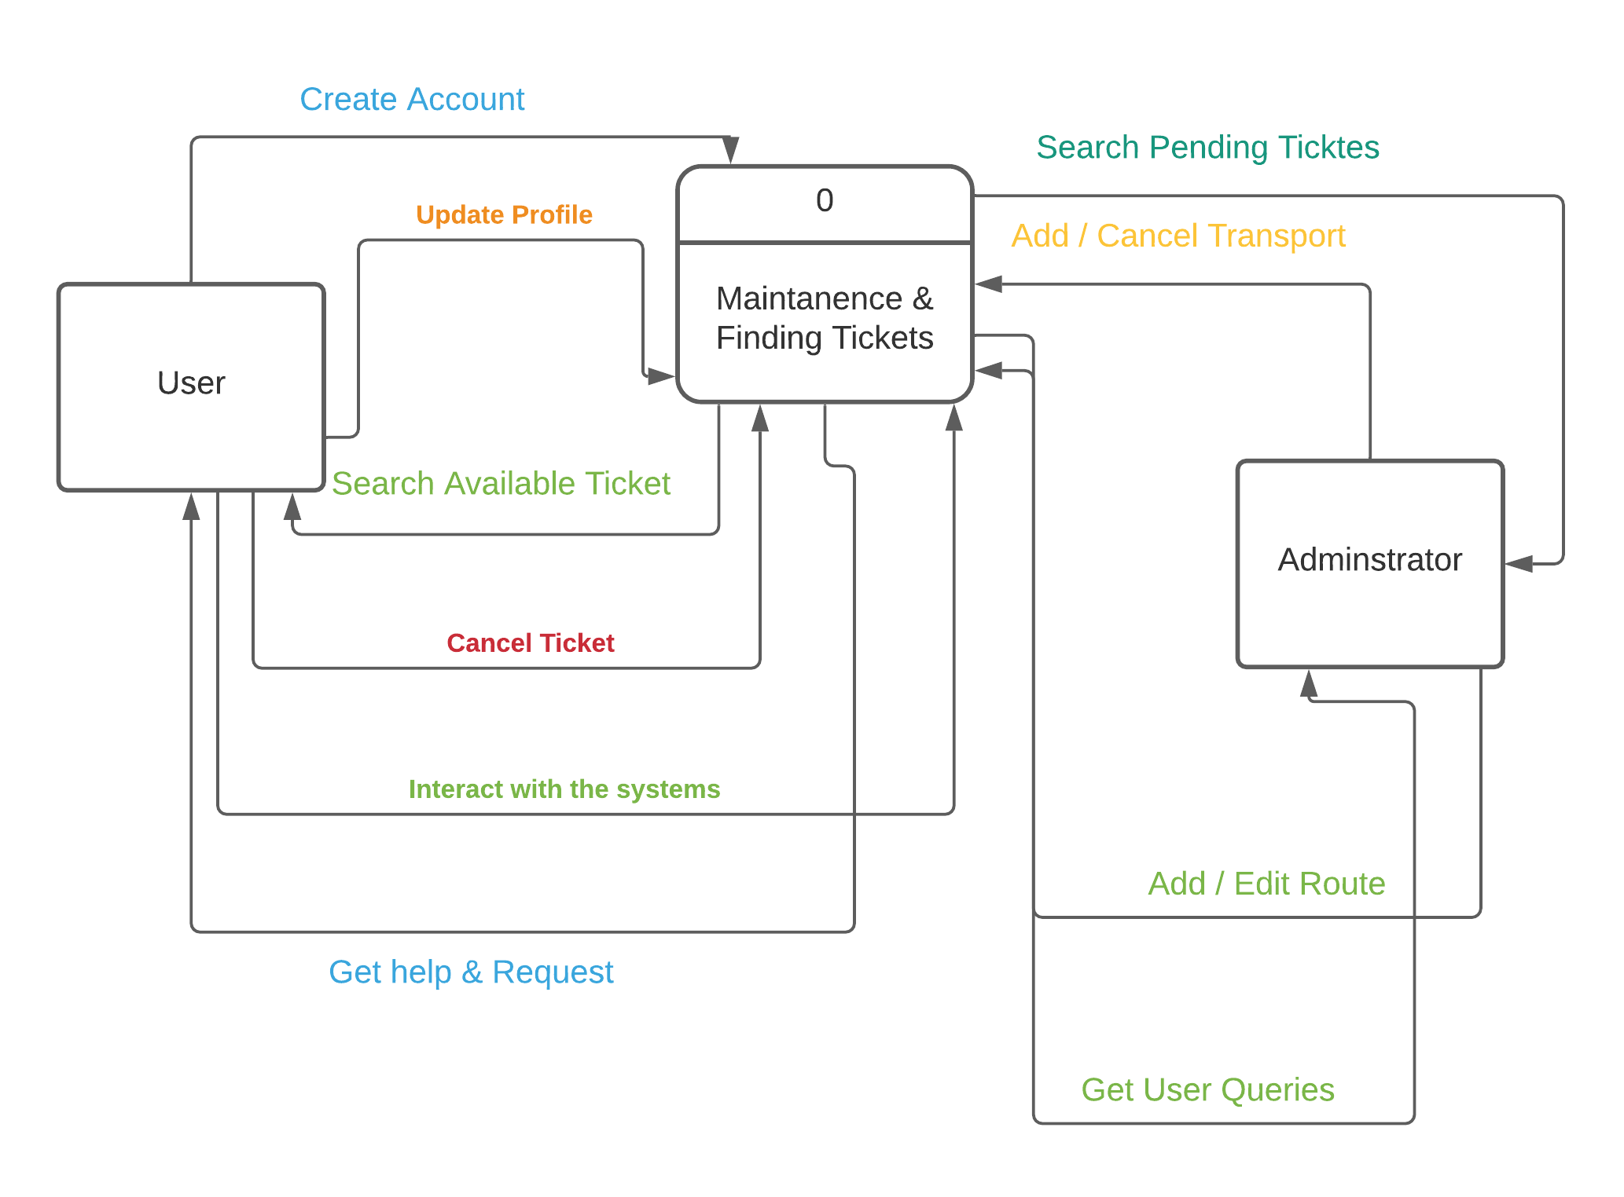
Construction Of The Context Level Diagram:
Figure: Level 0 Diagram

Slide 6
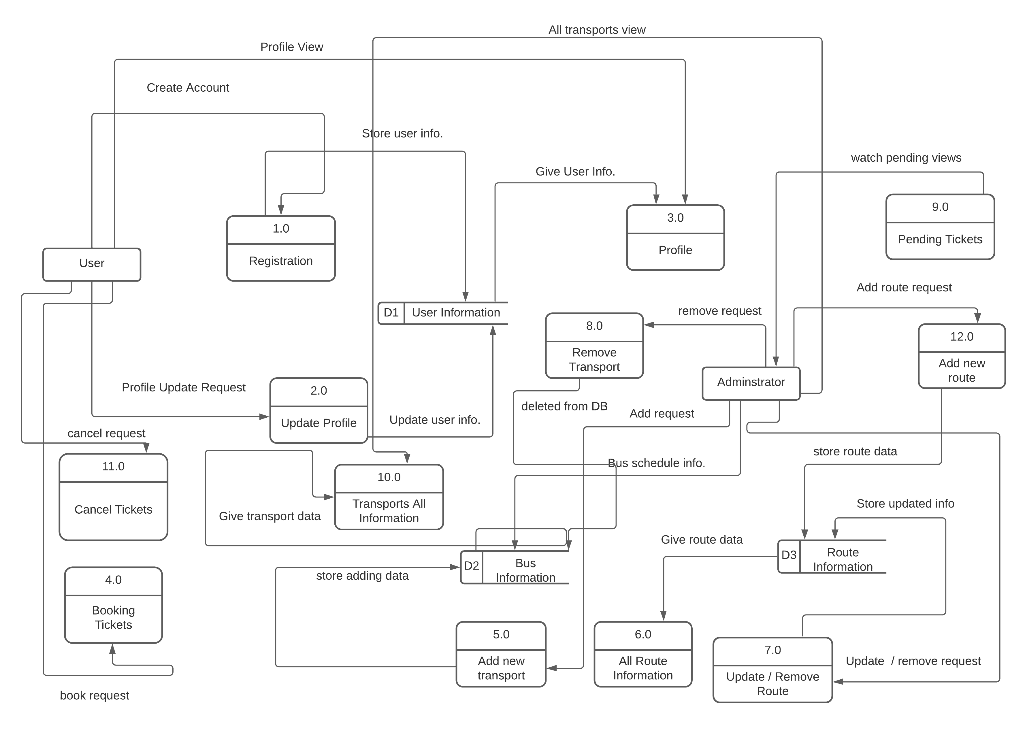
Construction Of Level 1 Diagram:
Figure: Level 1 Diagram

Slide 7
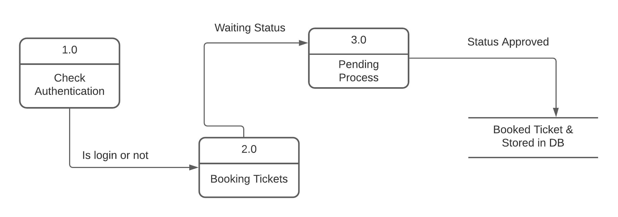
Construction Of Level 2 Diagram:
Figure: Level 2 Diagram

Slide 8
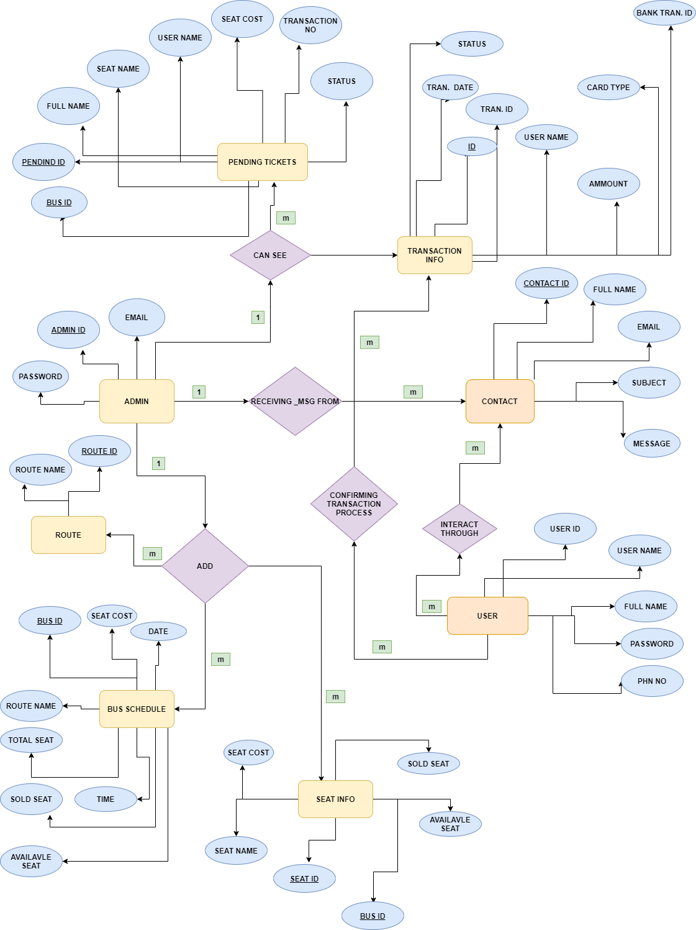
Entity Relationship Diagram:
Figure: Level 2 Diagram

Slide 9
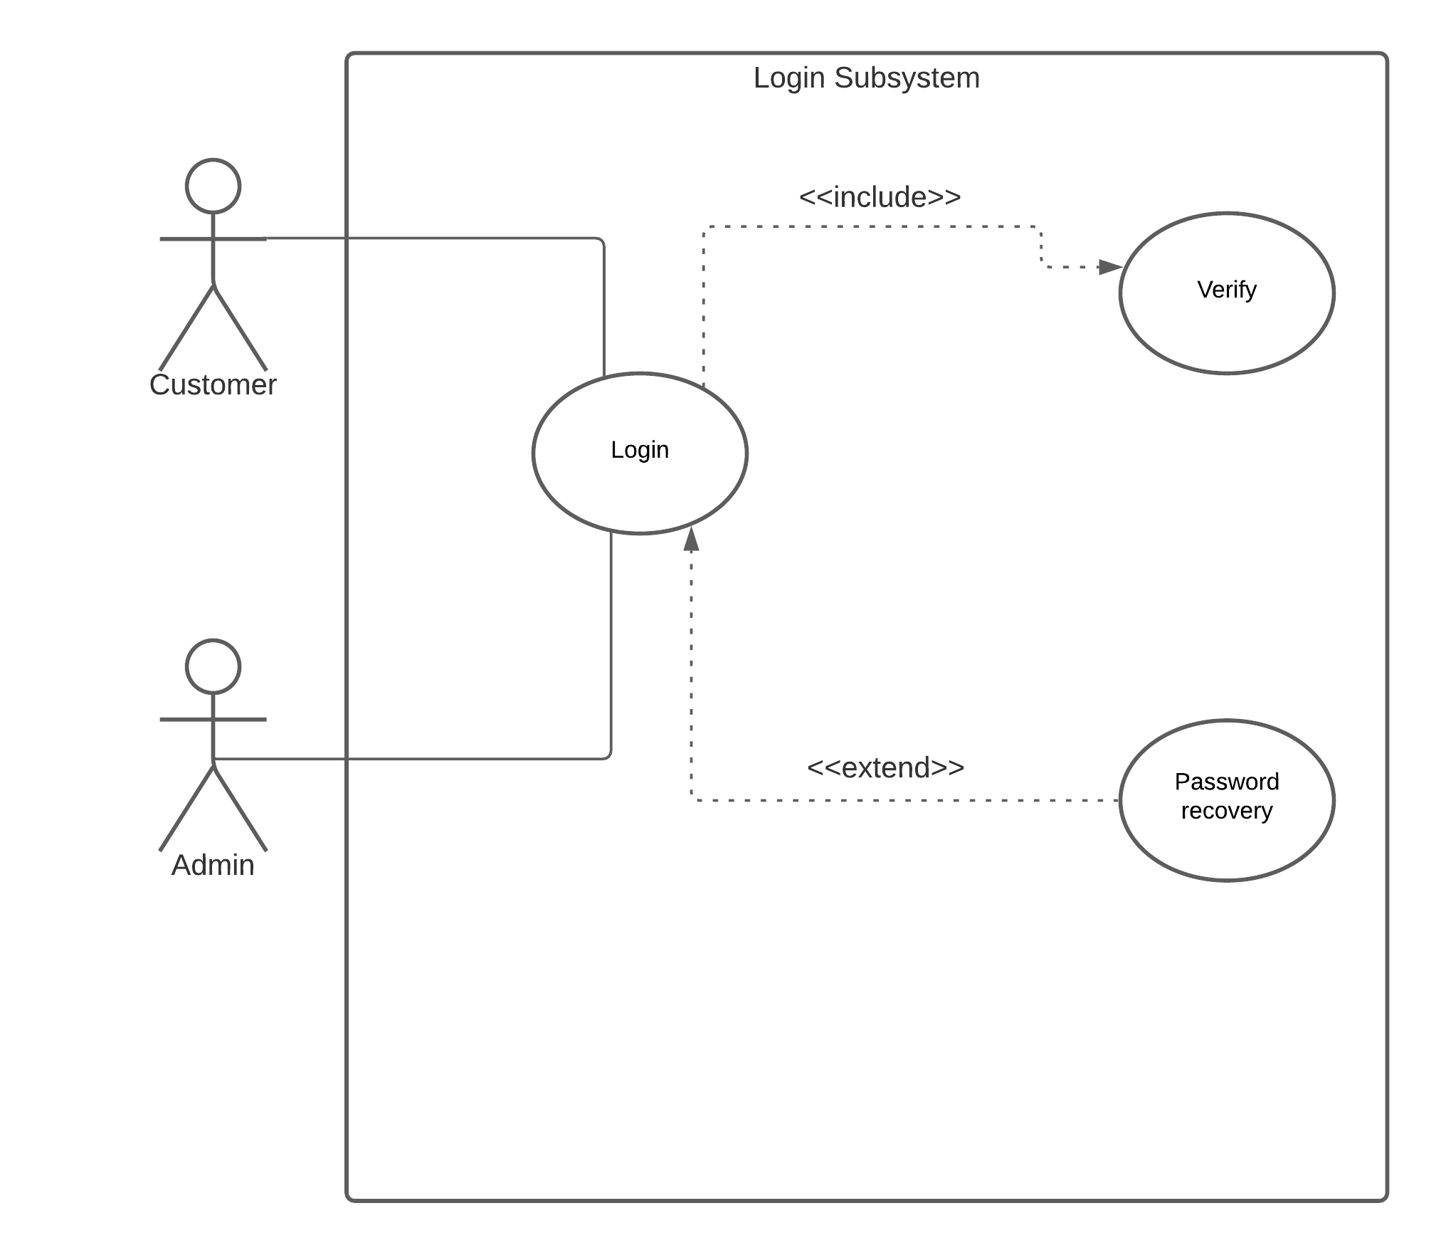
Use Case Diagram:
Actors: Admin, User.
Use Cases: Login Subsystem
Figure: Login Subsystem Diagram

Slide 10
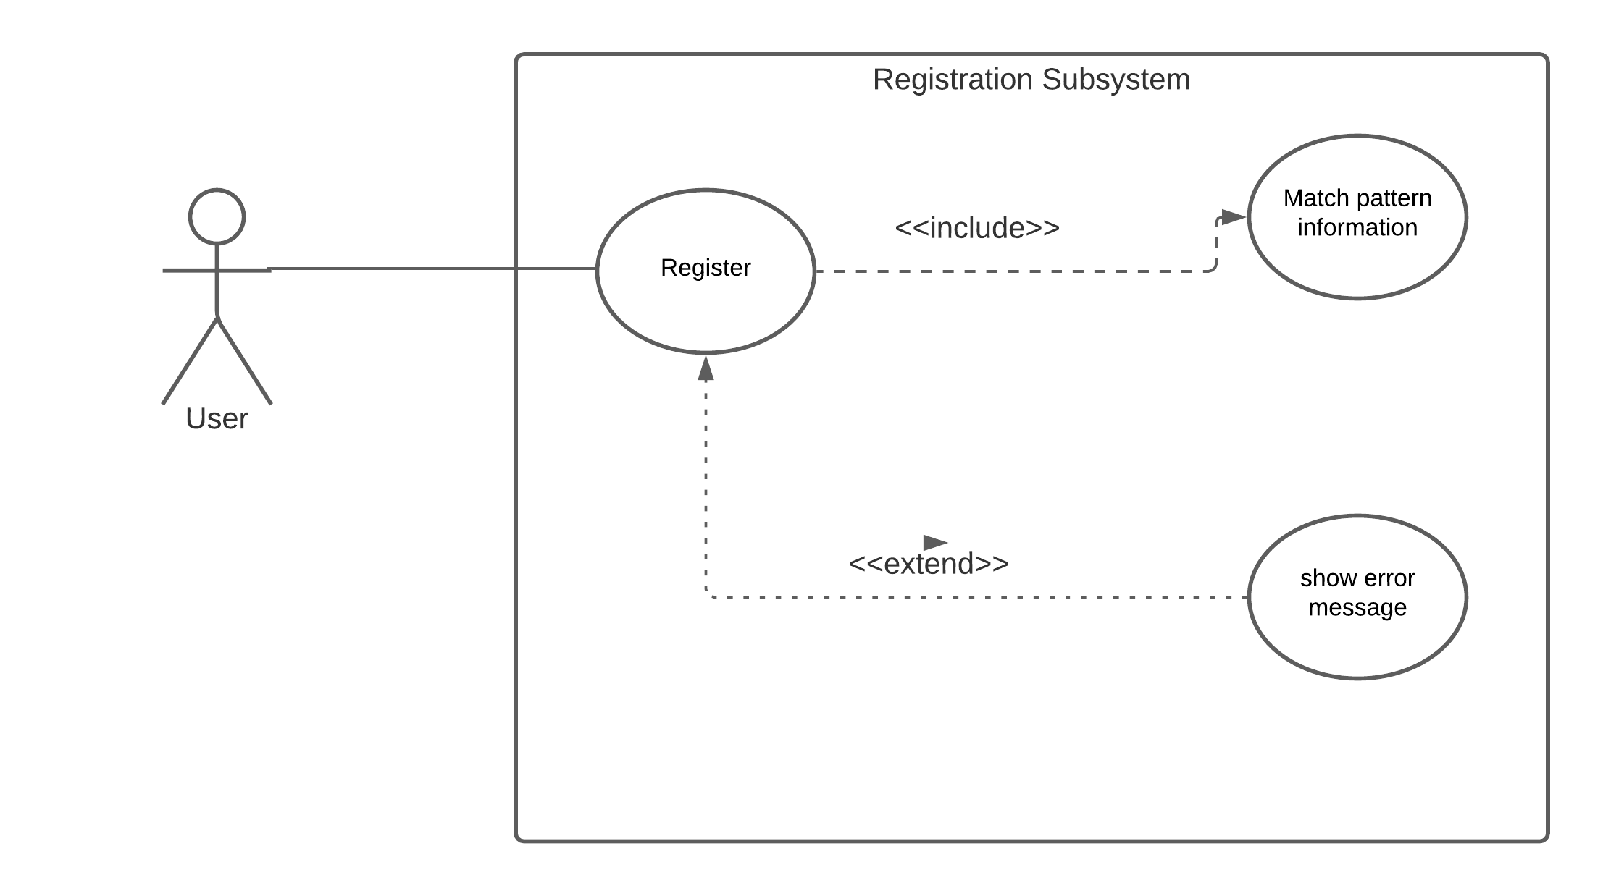
Use Case Diagram:
Actors: Non- User.
Use Cases: Registration Subsystem.
Figure: Registration Subsystem Diagram

Slide 11
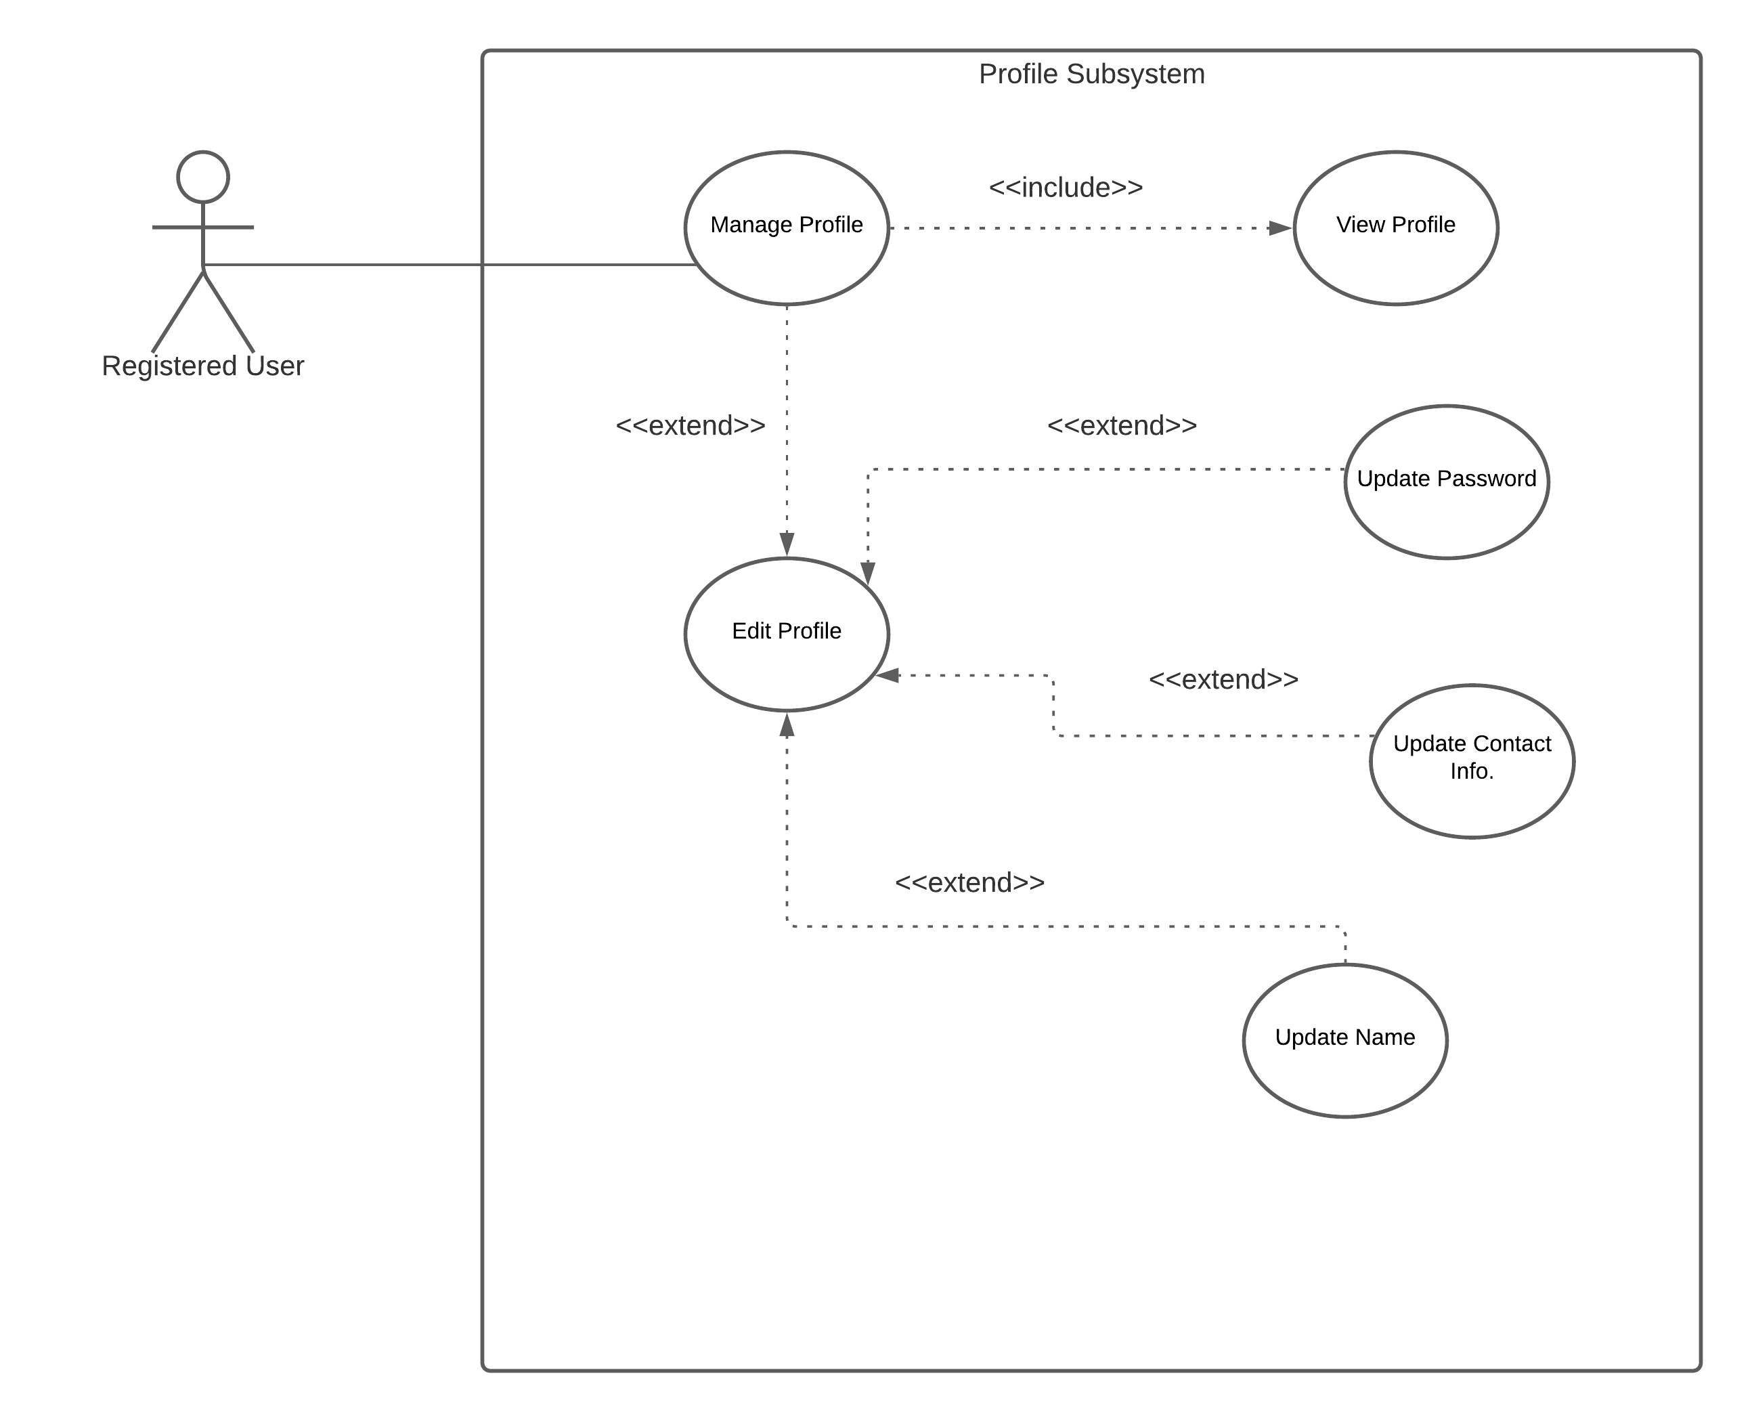
Use Case Diagram:
Actors: User.
Use Cases: Profile Subsystem (manage profile, edit profile).
Figure: Profile Subsystem Diagram

Slide 12
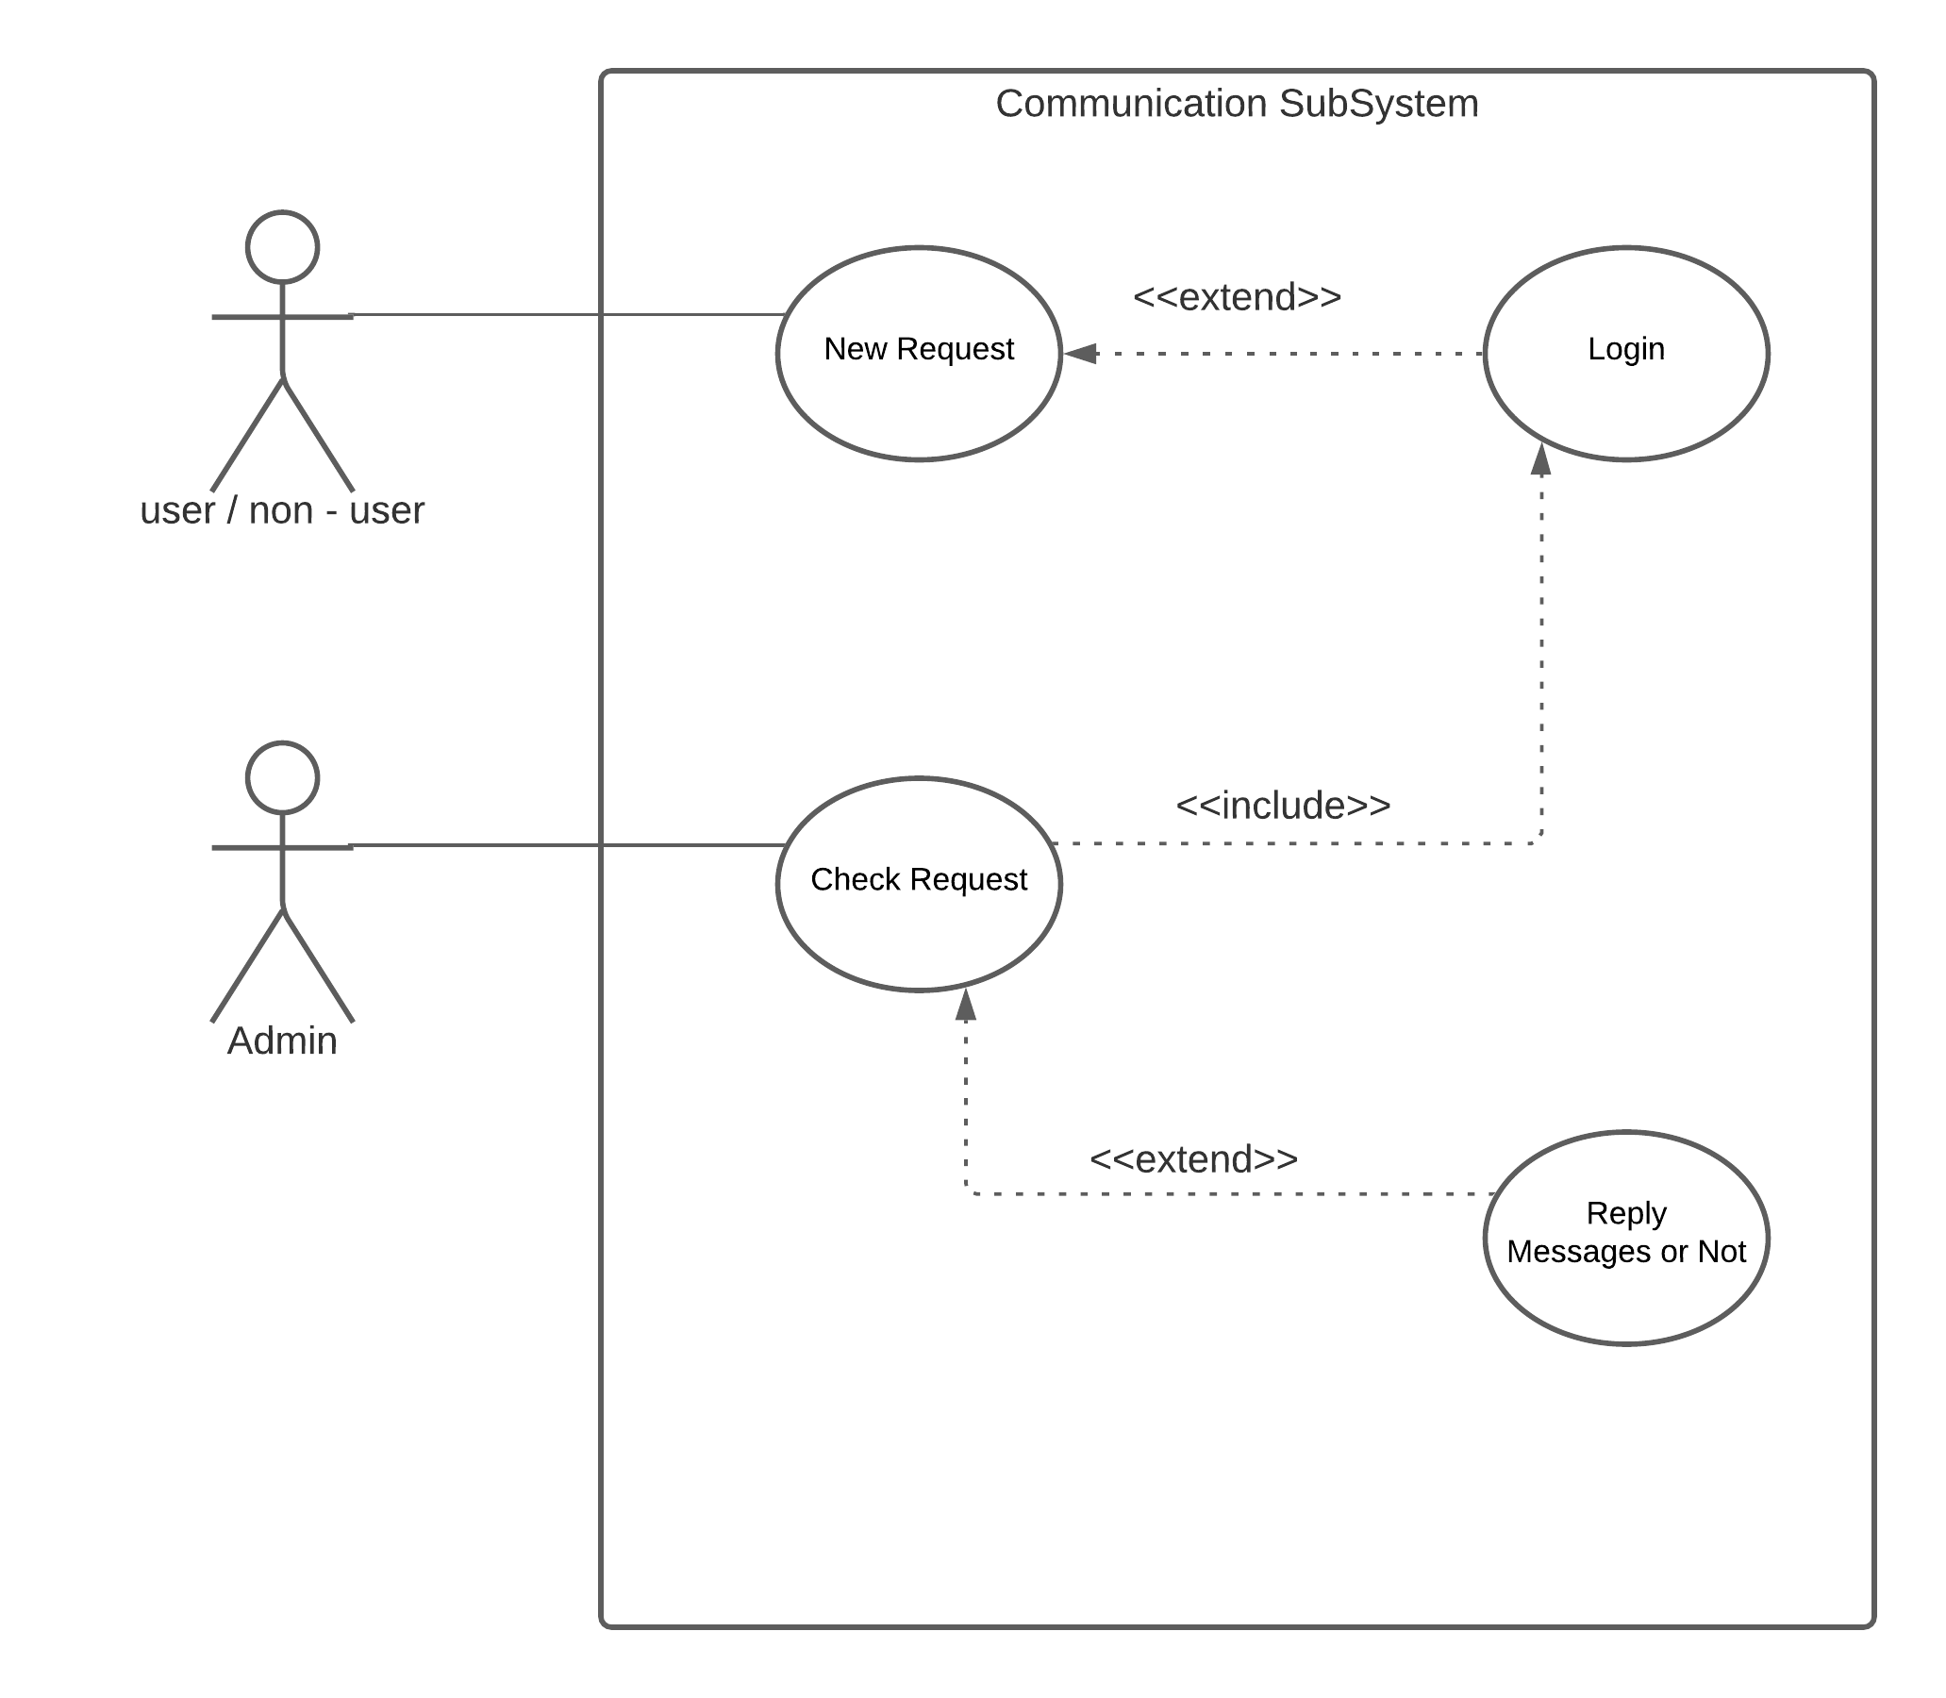
Use Case Diagram:
Actors: User, Non-User.
Use Cases: Communication Subsystem.
Figure: Communication Subsystem Diagram

Slide 13
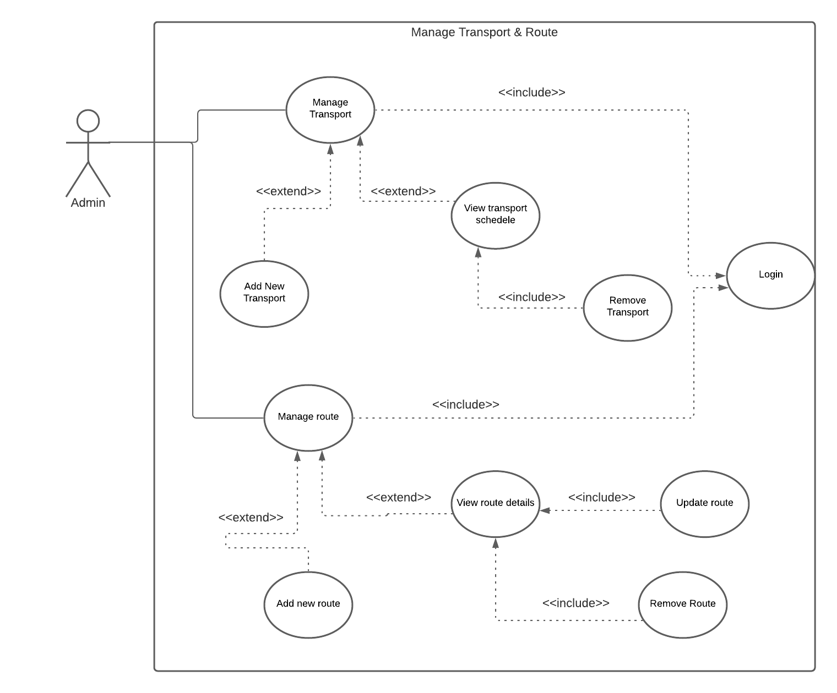
Use Case Diagram:
Actors: Admin.
Use Cases: Manage System(Transport & Route).
Figure : Management System (Transport & Route) Diagram.

Slide 14
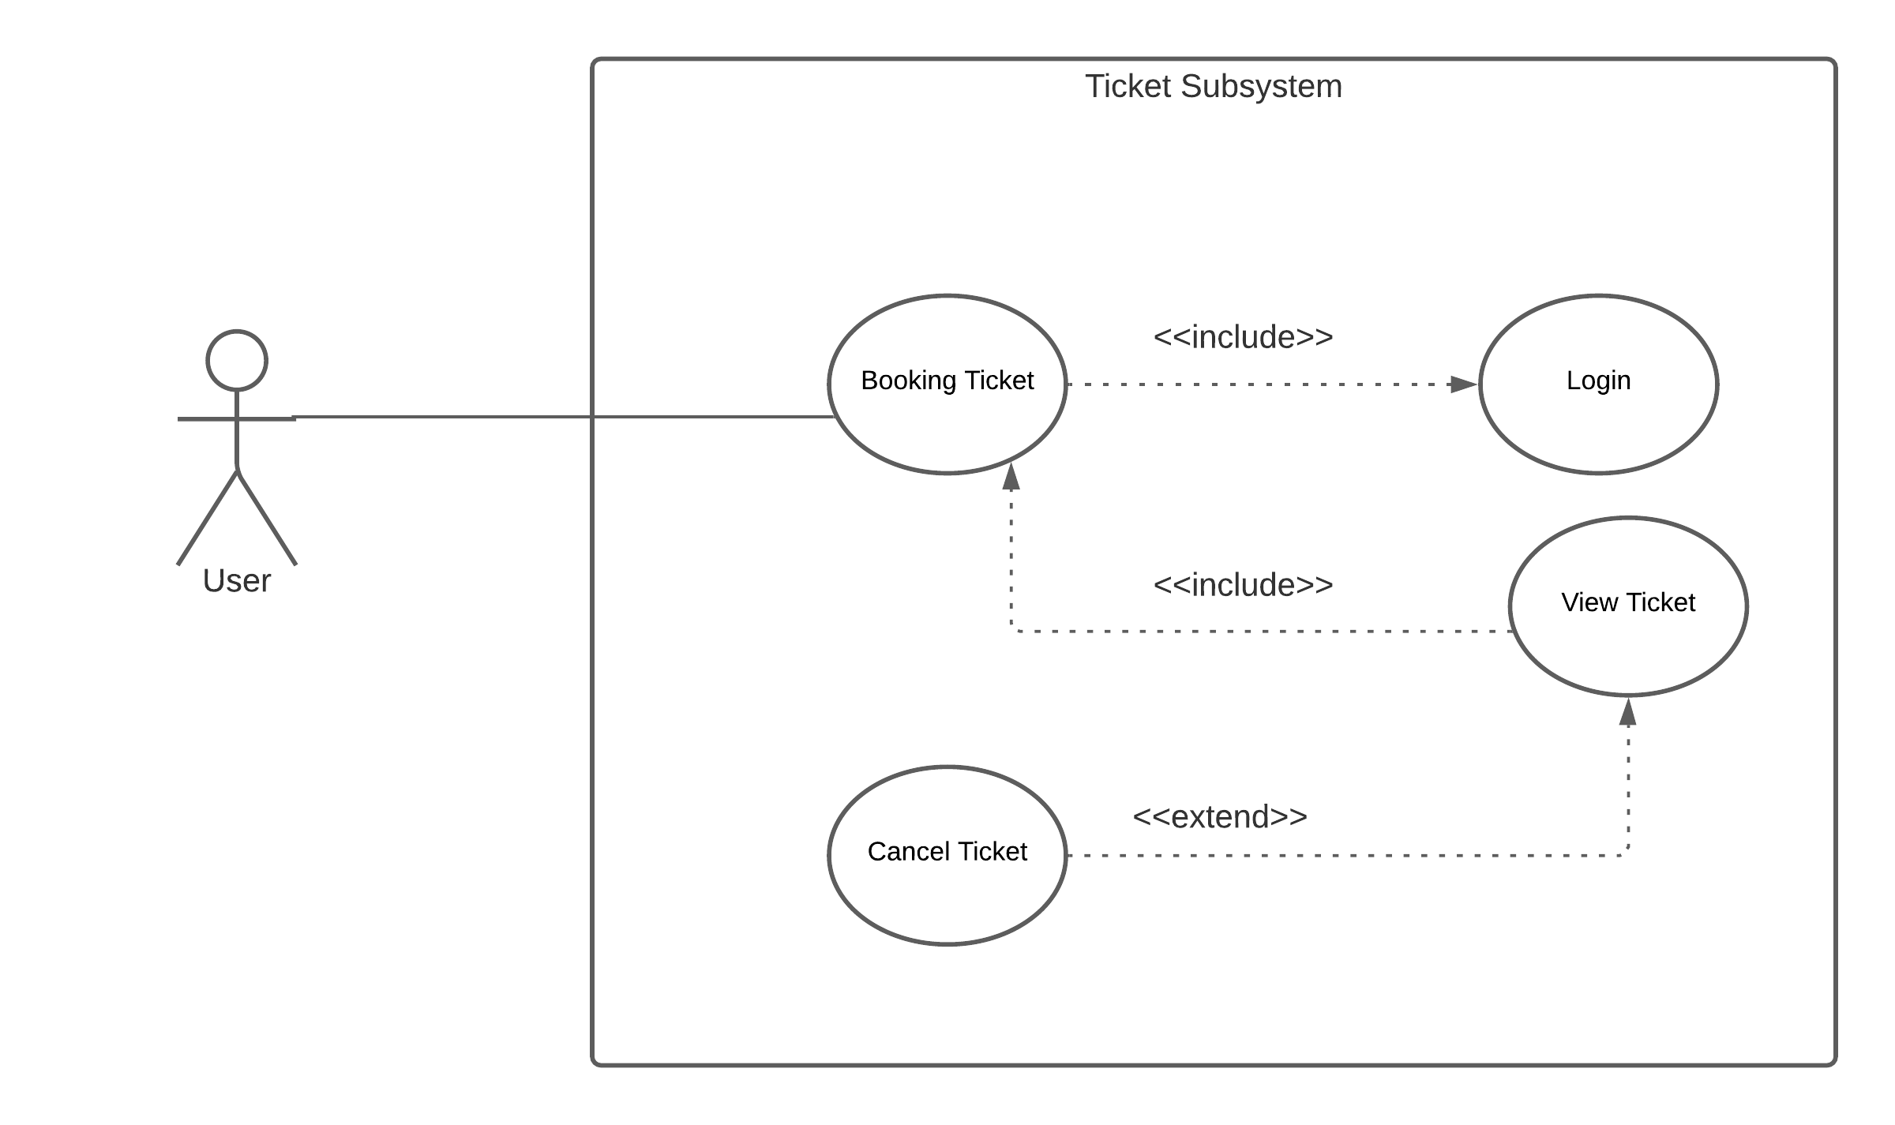
Use Case Diagram:
Actors: User.
Use Cases: Manage Ticket Subsystem.
Figure: Ticket Sub sytem Diagram

Slide 15
Project Demonstration
We have completed our project into 2 parts. One is USER panel and the other one is ADMIN panel.
In Admin Panel we have implemented some features . They are :
1) Manage Bus
2) Manage Route
3) Manage Pending Tickets
In User Panel we have implemented some features . They are :
1) Notification Window
2) Booking / Cancel Ticket
3) View / Edit User Profile

Slide 16
Future Plan
In future we will update our website adding some extra features also. These features will be :
Responsive Call Center
Air and Launch Ticket
Adding Live Map
Adding Voucher (Special Discount)

Slide 17
Conclusion
We hope this website will help the people to be more digital and will be successful in this platform.
We will try keep this website updated with the modern world.

Slide 18


Any Question?

